Slide 2

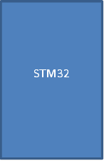
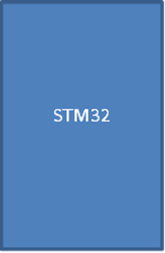




BLOCK DIAGRAM:
Breaking system
Cooling system
Alert system
PWM
humidity
sensor
Motor drive
wiper

